Slide 1

How to use the ColdFusion API Manager to modernize your App
Dan Wilson
Notes:
API driven world
Dealing with existing apps is hard
Doing it the wrong way is time consuming and expensive, or could go REALLY bad.

Slide 2
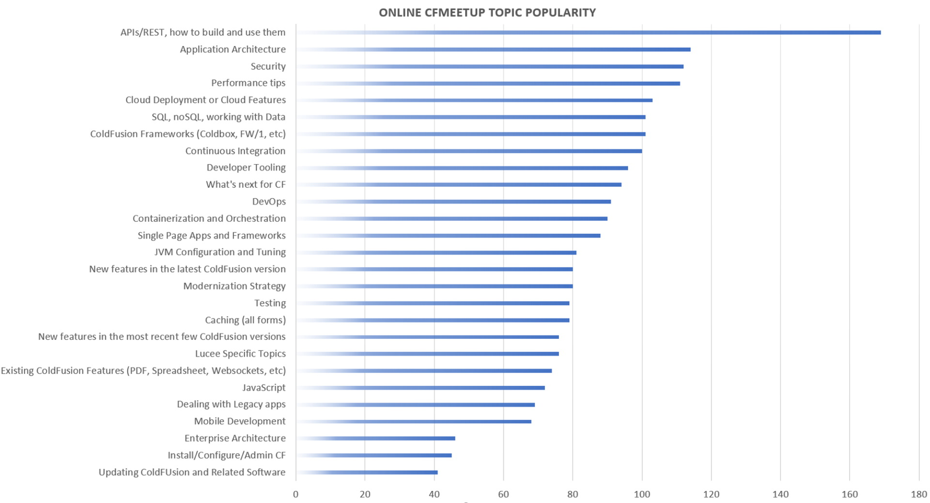

Slide 3

“The Enterprise React Company”
Long time Adobe partners
Flex/Air Community Leaders
Enterprise React Newsletter
https://tinyurl.com/er-news

Slide 4
Shift in trends
Thick Client
Thick Client - Web
Installable apps with proprietary runtimes
Interfaces are rich
App version updates are hard
Few cross-platform options
Open runtimes and standards
Highly interactive full-gloss experiences
Cross platform
App version updates are instant
2000-2007
2007-2012
Pre-1999
2020
Thin Client
Thick Client - RIA
Web apps
Reload interface for every user action
Interfaces are simple
App version updates are instant
Runtime is web browser and cross platform
Flex, Silverlight
Highly interactive
Full-gloss branded experiences
Closed, Proprietary Runtime
Cross platform
Updates are Easy
Notes:
Technology changes, one trend that seems worth betting on is to agree there will be new consumers of your data, be it other clients, user interfaces, or technology.

Slide 5

Definition of Legacy
Notes:
It works!

Slide 6

Common issues with Legacy
Poor testing
Mix of concerns
Many hands, over many years
No one knows everything it does
Hard to scale
Technical debt accumulation
Notes:
Lack of unit tests
Violation of the Single Responsibility Principle
High complexity leads to more time spent in maintenance activities
Inability to scale individual components to meet increased demand
Tight coupling between components makes it difficult to deploy regularly
Technical debt accumulated over time and makes future development difficult

Slide 7

Fear
Notes:
This results in a fear of touching the application because something might break.

Slide 8
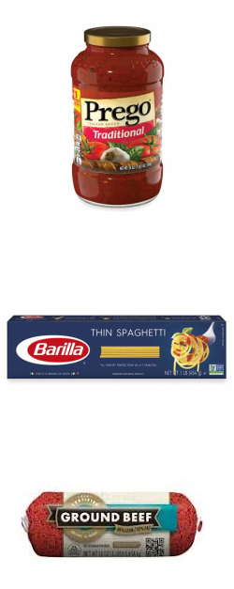
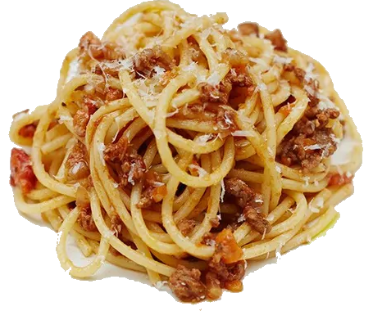
Inseparable
Presentation Layer & UI
Monolithic App
Business Logic
Data
Notes:
Once everything is mixed up, it can be impossible to get it all back out again

Slide 9
On Scaling
Performance constrained section of app
Notes:
One common problem we get is scaling issues.
Often a small part of the app is bottlenecked, but it can be problematic to scale the app if everything is intertwined.

Slide 10
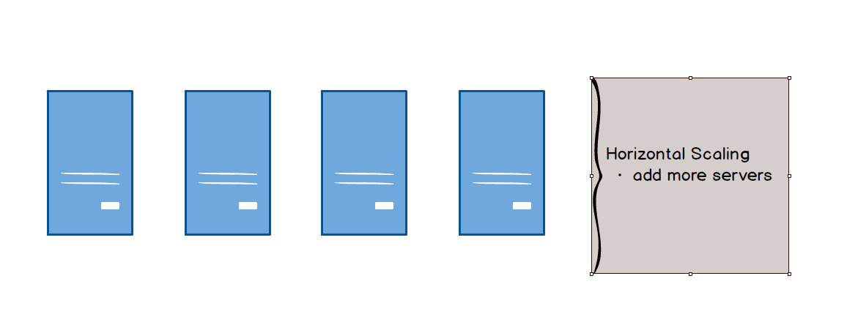

Scaling
Notes:
Horizontal scaling works, as long as it works. If it doesn’t you are hosed.

Slide 11
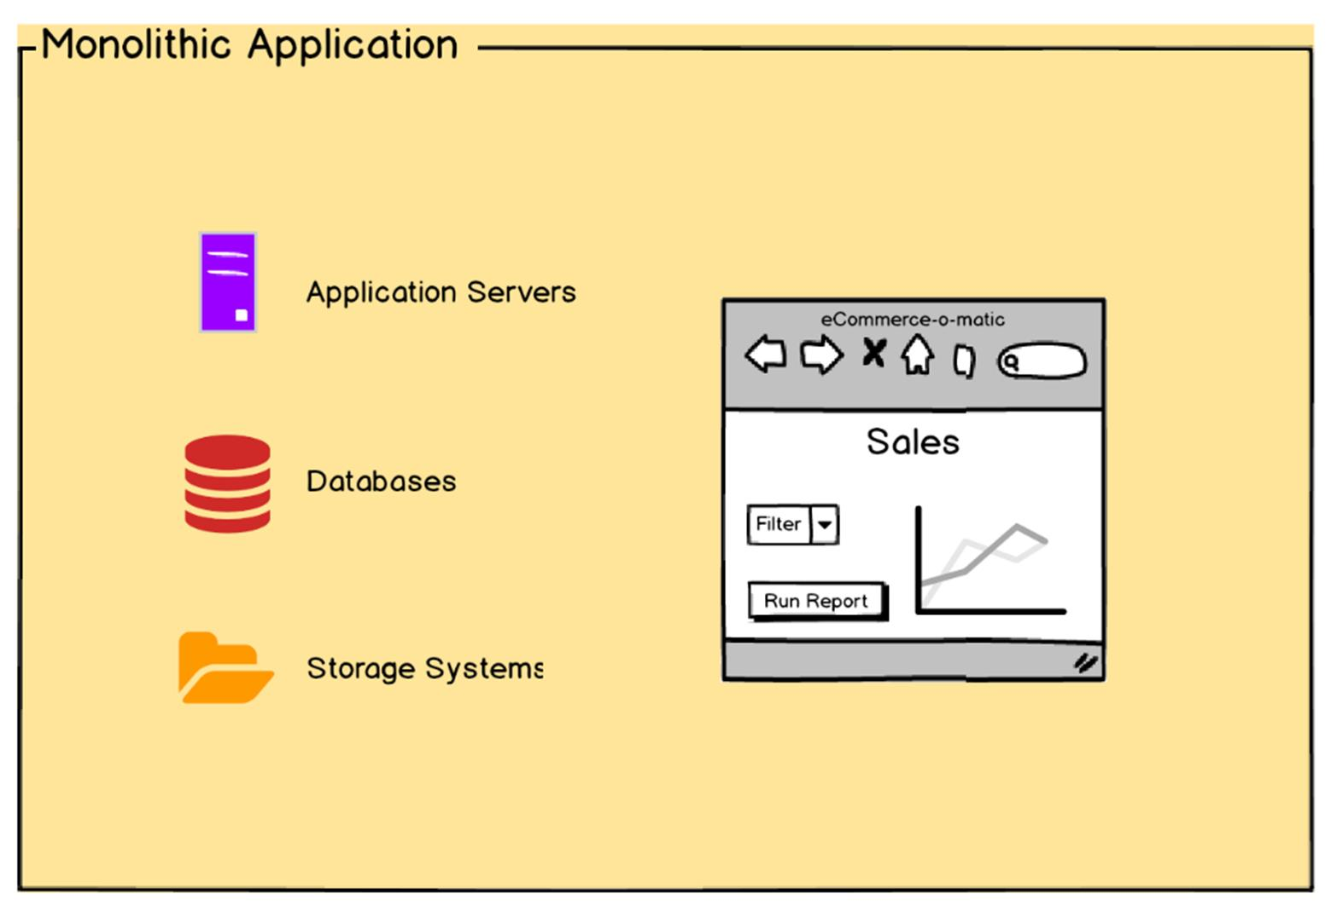
Gaze inside the Monolith
Notes:
Let’s example a fictional ecommerce app. Here’s what it breaks down to.

Slide 12
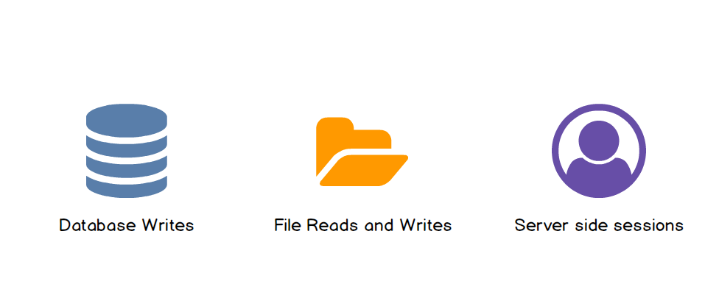
What doesn’t scale horizontally
Notes:
Also CF Sessions, Server Scope, etc

Slide 13

Custom Software in the Wild
Notes:
Here’s an example of an enterprise app portfolio
Many different kinds of tech
Many different people who developed it
Many different standards
Many different architectures.
How do you tame the beast?

Slide 14

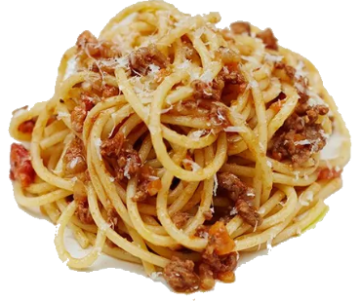


Or Maybe not…
Presentation Layer & UI
Business Logic & Data
Notes:
It is possible to get the noodles out, if you do it the right way. The other parts are too tied up to be worth it.

Slide 15
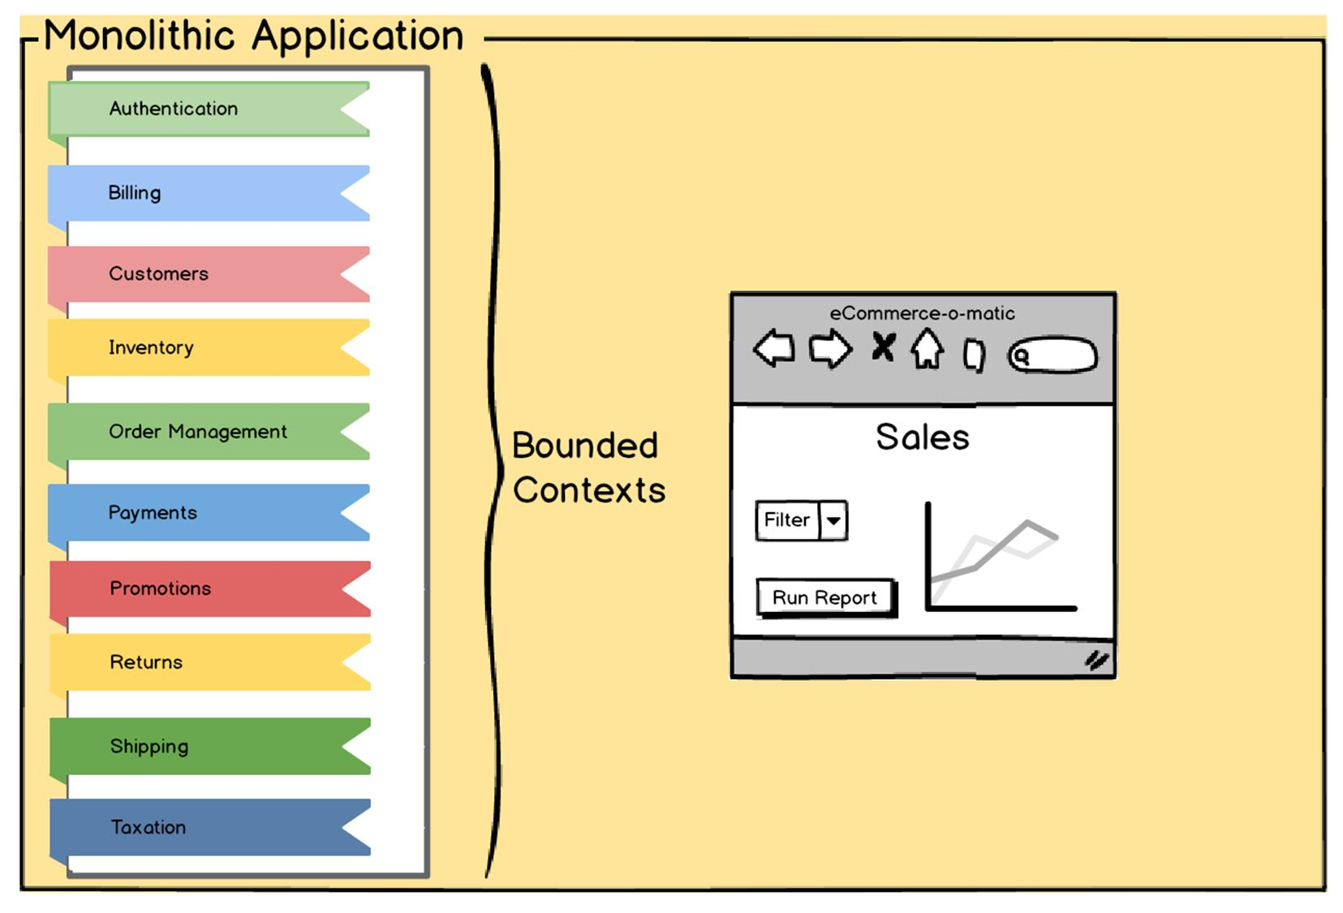
Contexts
Notes:
Block out the main concepts in the app. There may be some overlap but try to avoid it.
Think from the perspective of the developer

Slide 16
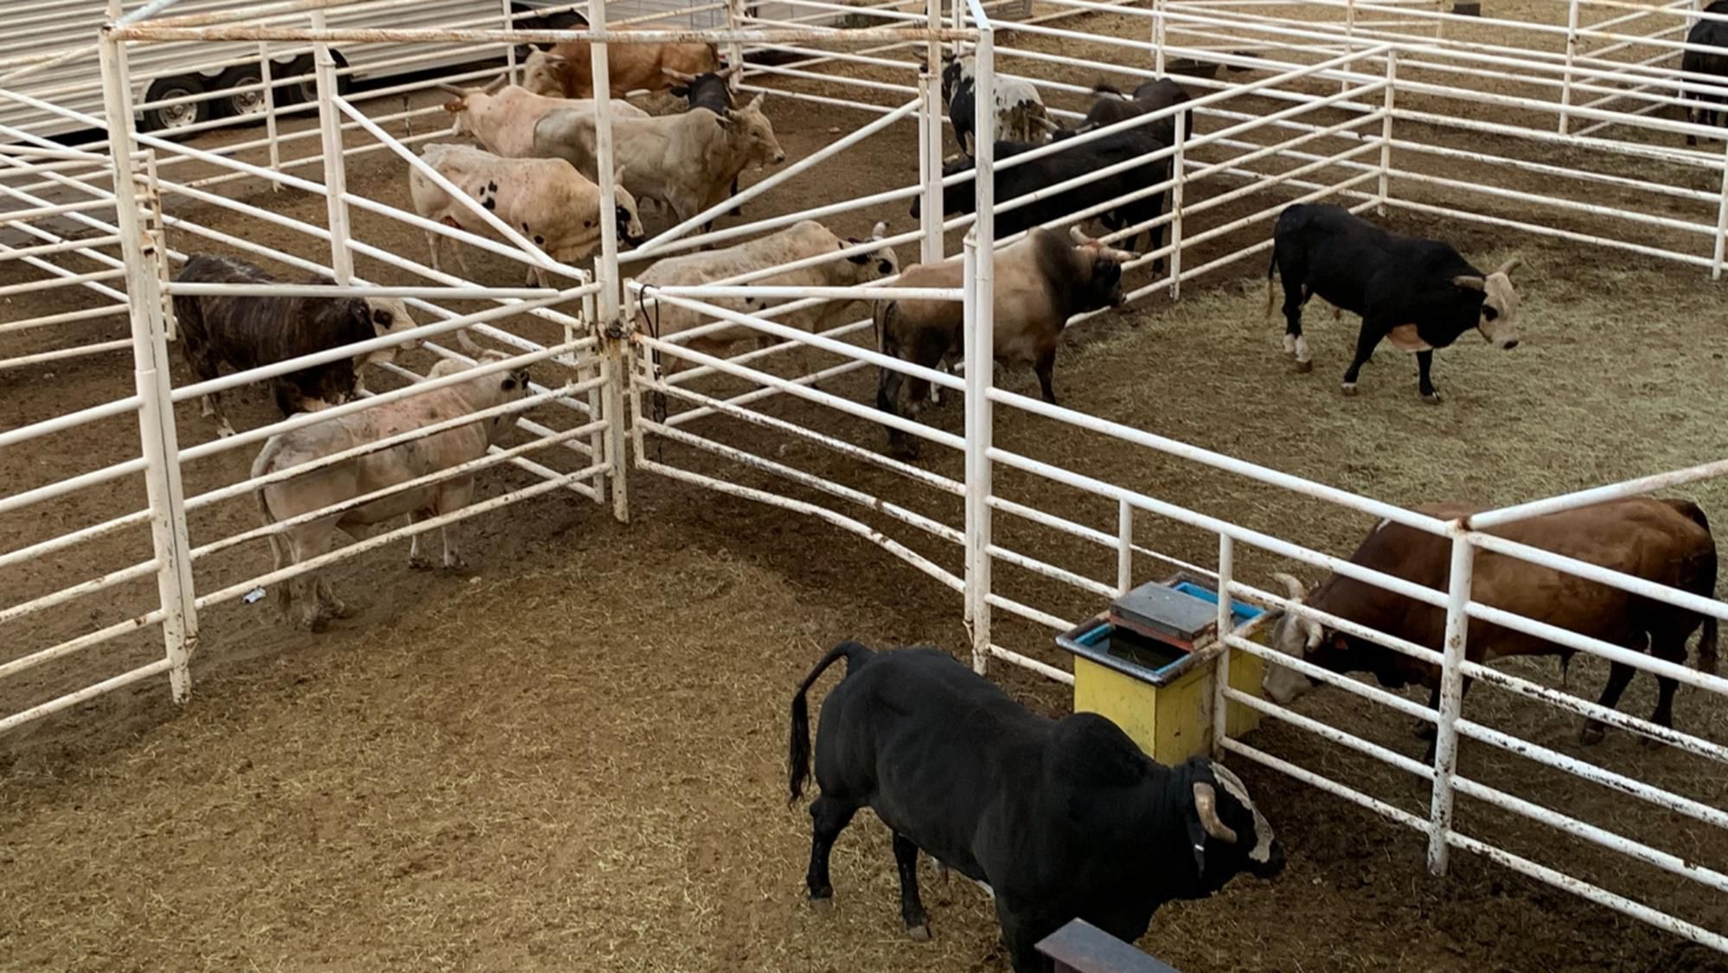
Digital Fences
Notes:
Like our ancestors did, with fences!

Slide 17
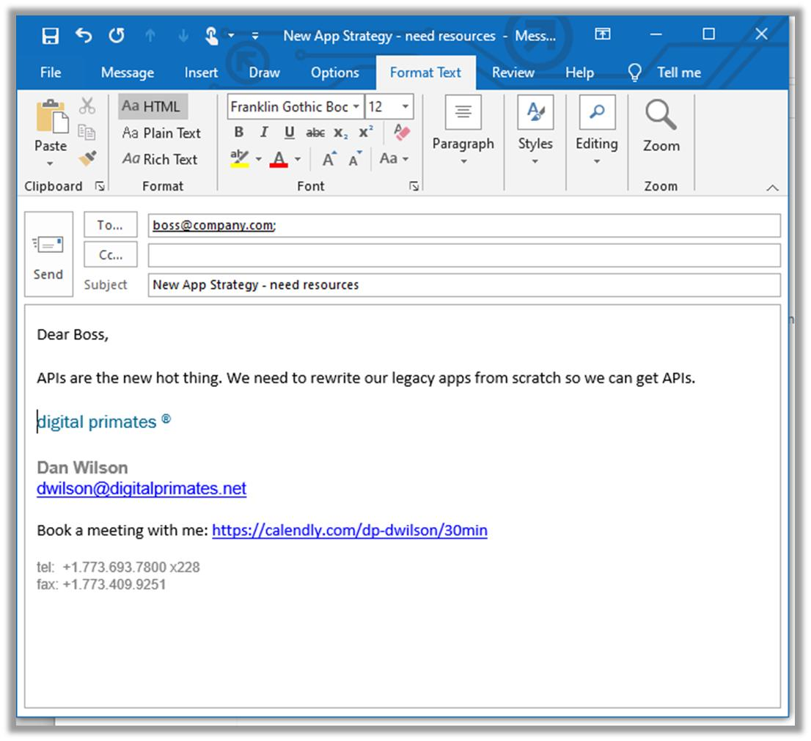
How to migrate your app – Step 1
Notes:
So just send your boss an email…

Slide 18

How to migrate your app – Step 2
LOL.
Tell me another joke.
Notes:
And he/she will laugh at you.
No one wants to pay a bunch of money for the same business solution
Plus, it wouldn’t work anyway. See spaghetti modeling

Slide 19
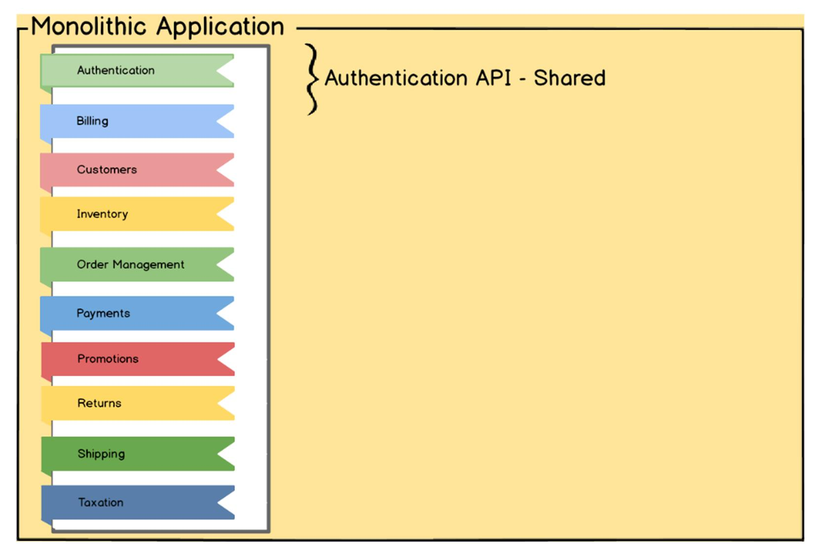
Composition
Authenticate a User
Authenticate a User with one time password
Change Password for a User
Complete Two Factor Authentication
Export Login Records
Logout a User
Update Login
Search Login Records
Notes:
Now make your API

Slide 20
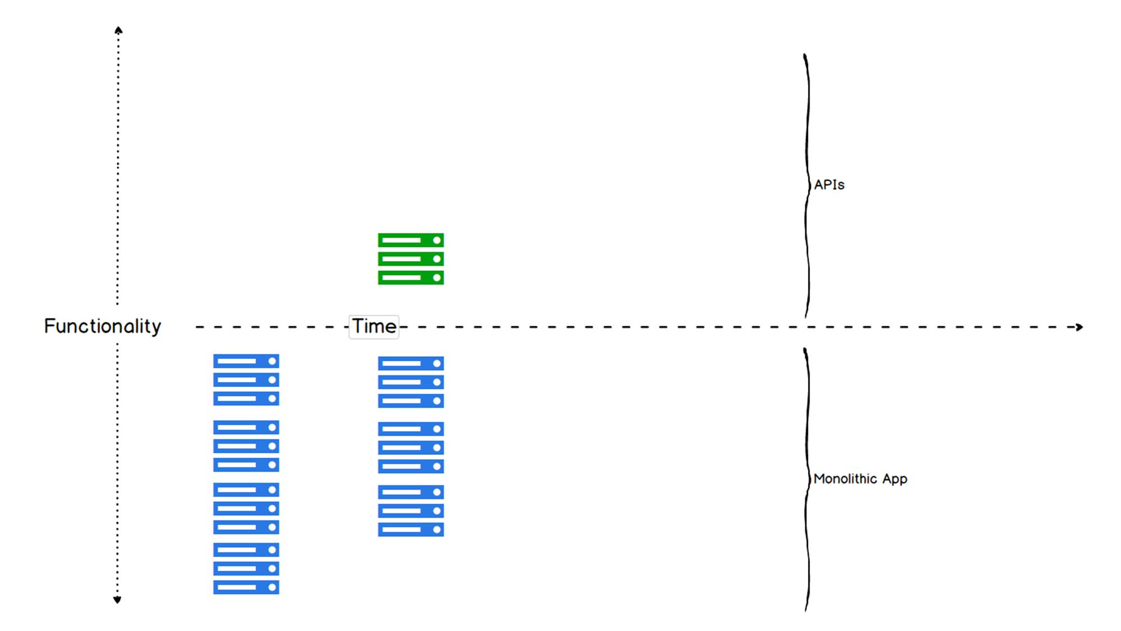
Progressive Migration
Notes:
One strategy is progressive migration. This is a prioritized approach that moves portions of the app out, while preserving the application and functionality

Slide 21
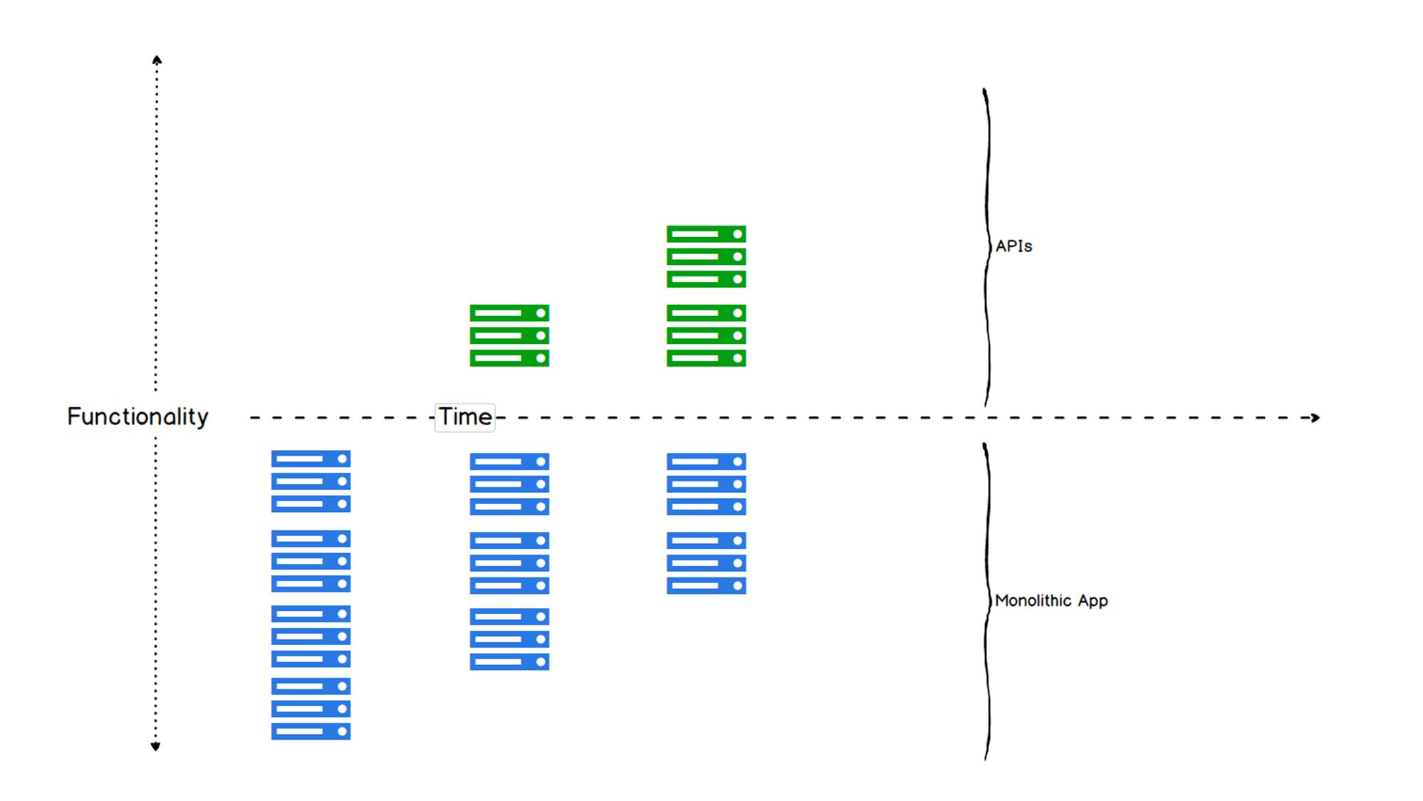
Progressive Migration
Notes:
One strategy is progressive migration. This is a prioritized approach that moves portions of the app out, while preserving the application and functionality

Slide 22
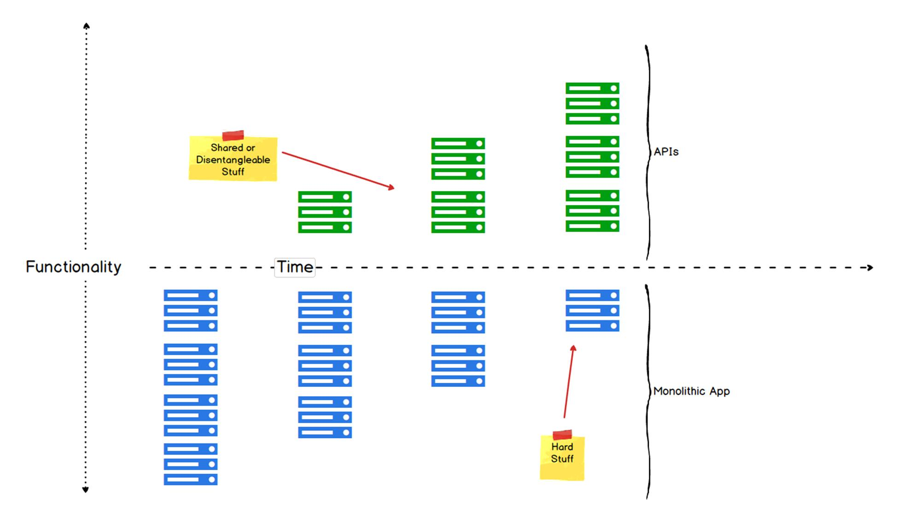
Migration Philosophy
Notes:
Disentangle the disentangleable
Ignore the rest and fence it off

Slide 23

Do Not Fall Into Temptation
Notes:
This is surgery
You want a stable app so you can cleanly validate.
Now isn’t the time to start bolting on new features or you’ll end up with a mess.

Slide 24
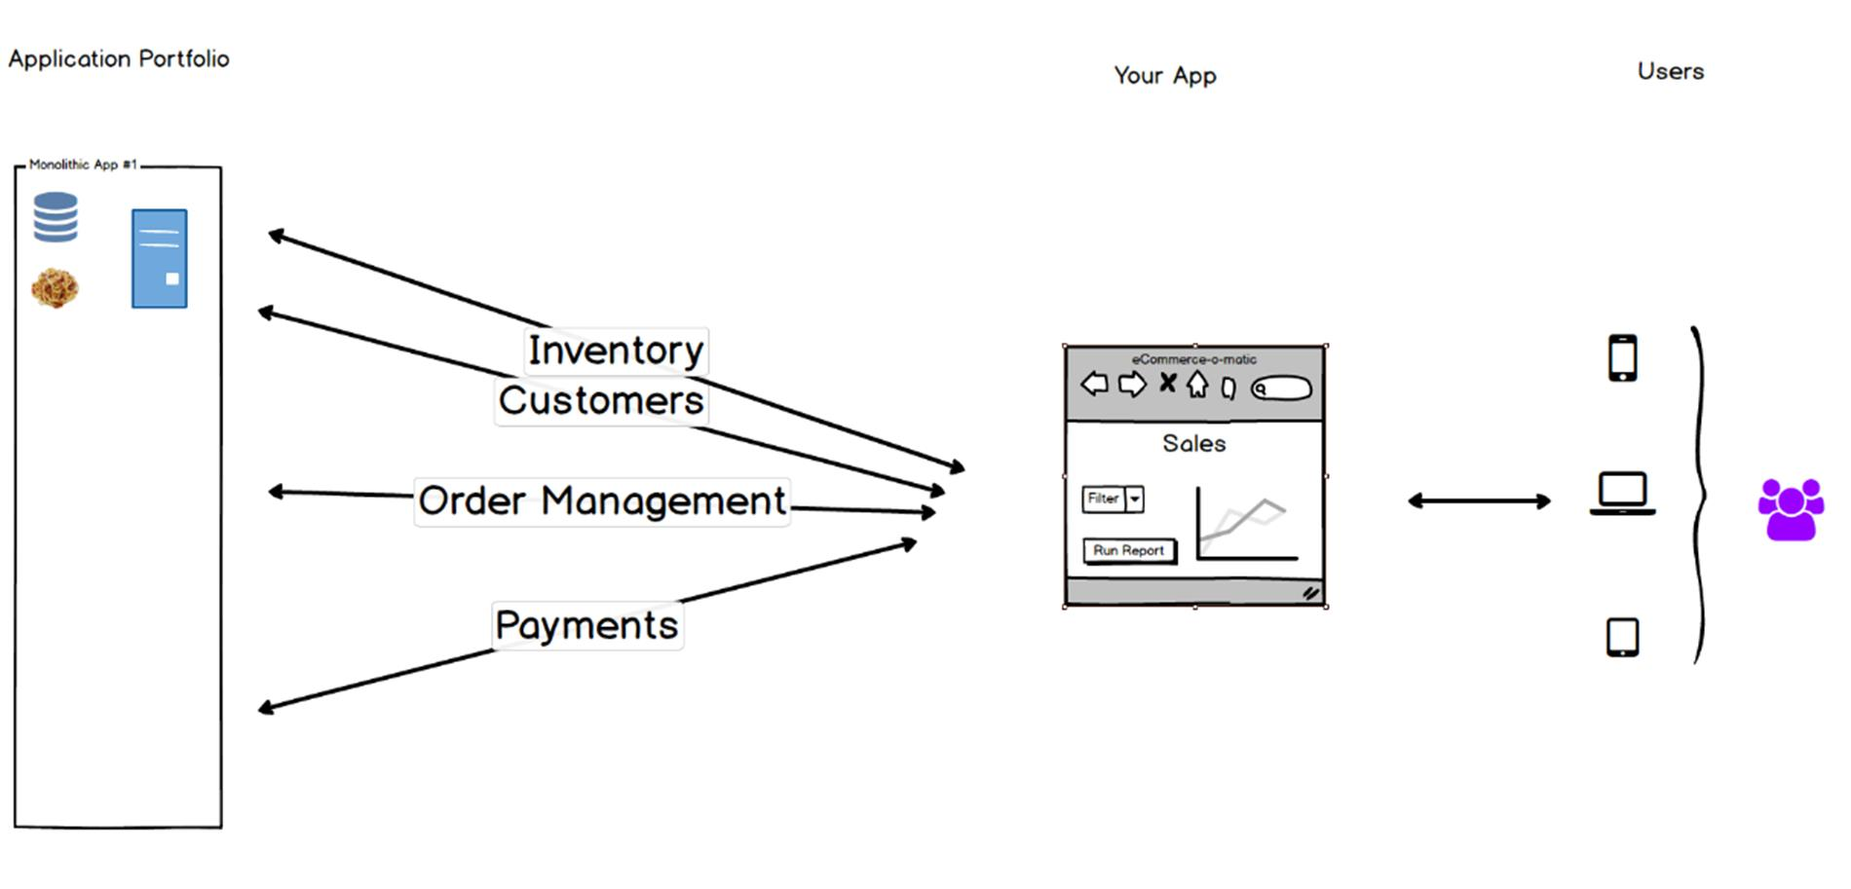
Beginning State
Notes:
Take a monolithic e-Commerce app

Slide 25
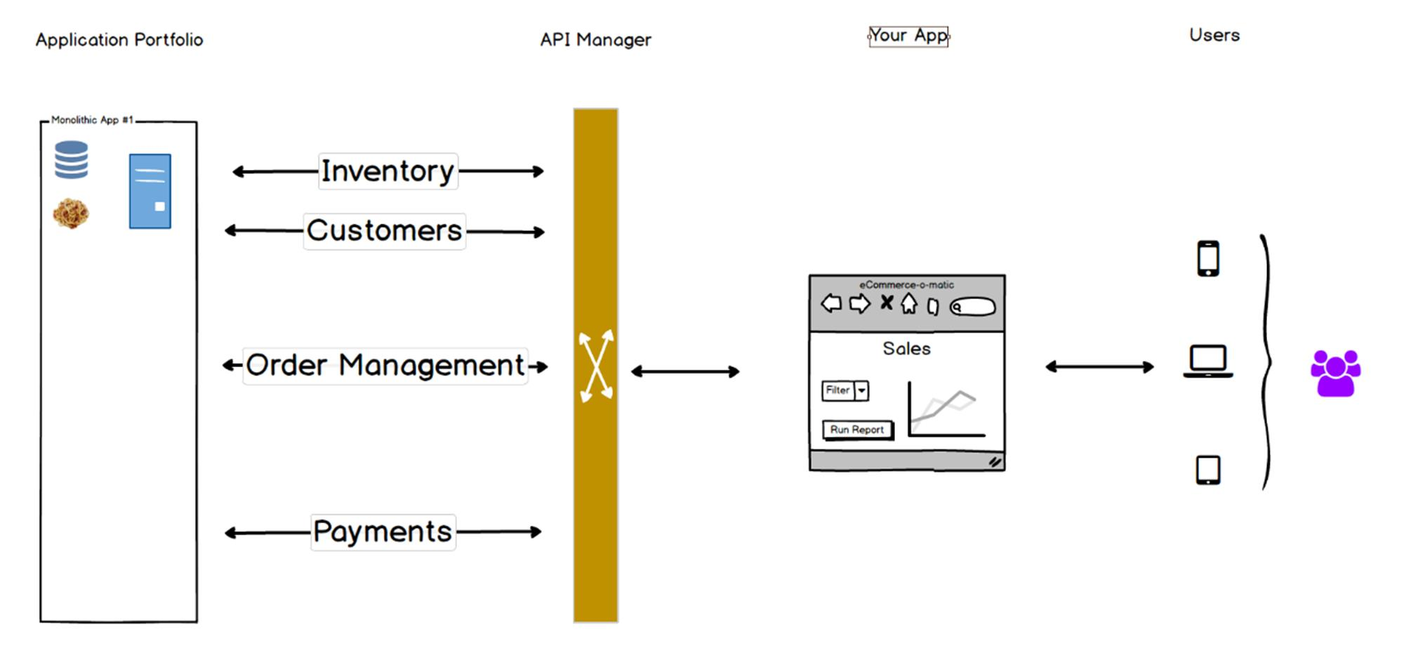
Middle State
Notes:
Step 1, leave the app alone, but make APIs around the key concepts
Test app. If functionality is same as Production, You did a good job
This is not the time to add things to the app. Leave it alone.

Slide 26
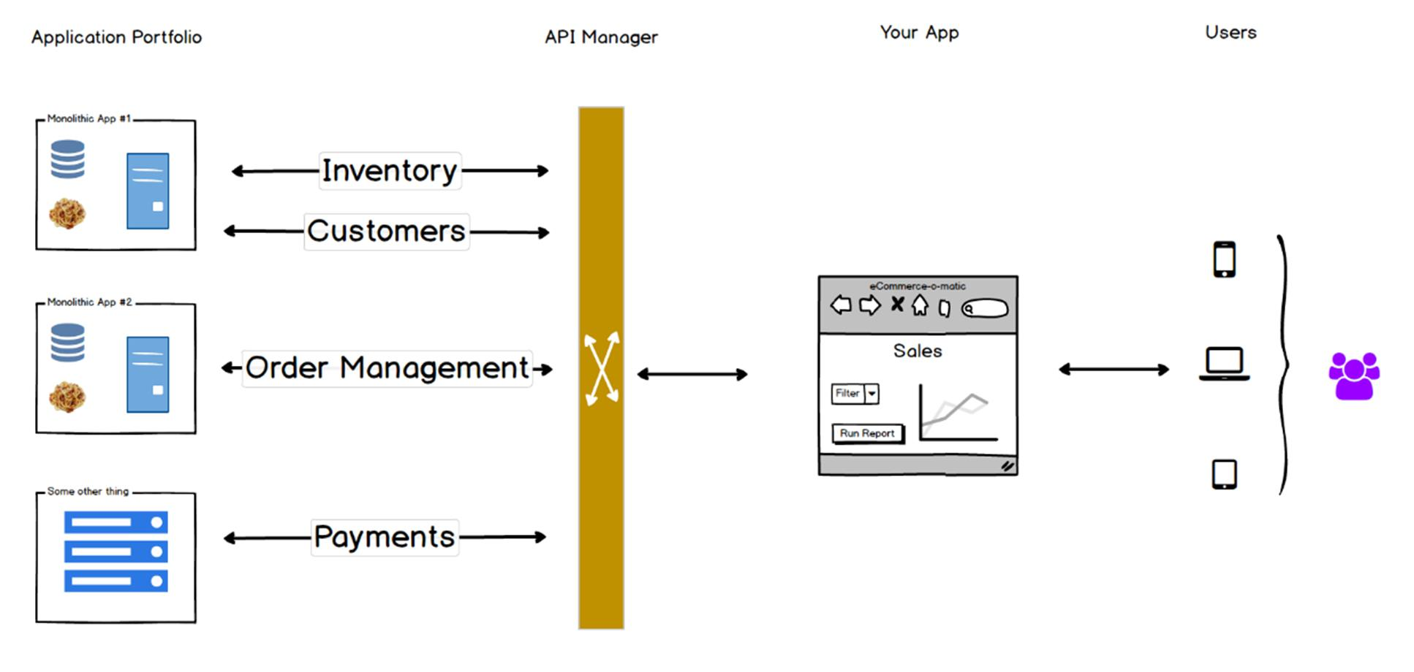
End State
Notes:
Then, move the APIs off into their own containers.
The front-end app doesn’t have to change because none of the APIs will change

Slide 27
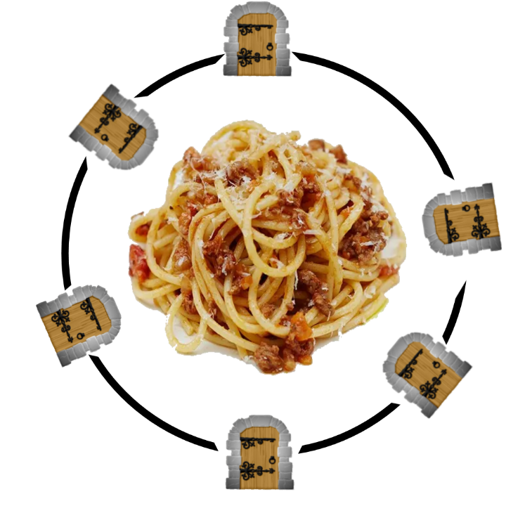
Digital Fence
Notes:
Here is the same idea in spaghetti form. Limit in/out. The insides can stay the same.

Slide 28

Design Good APIs
Notes:
Simplify what the interface is, and it doesn’t matter what is on the other ends.
This wire can carry email, videos, voice, and the adapter doesn’t have to know.

Slide 29

Notes:
Does this mean you have to go 100% APIs and redo everything? Nope.
See this monolithic app? We’ve got very few ways in and out, so we can leave the innards alone and they won’t hurt anyone

Slide 30

Bonus Feature: Decoupled Development
Notes:
Since you can plug/unplug APIs at will, you can make mock APIs for your front-end teams so they have data to play with
Then when the back end teams are done, they can swap the API for the real one, and no one is blocked

Slide 31
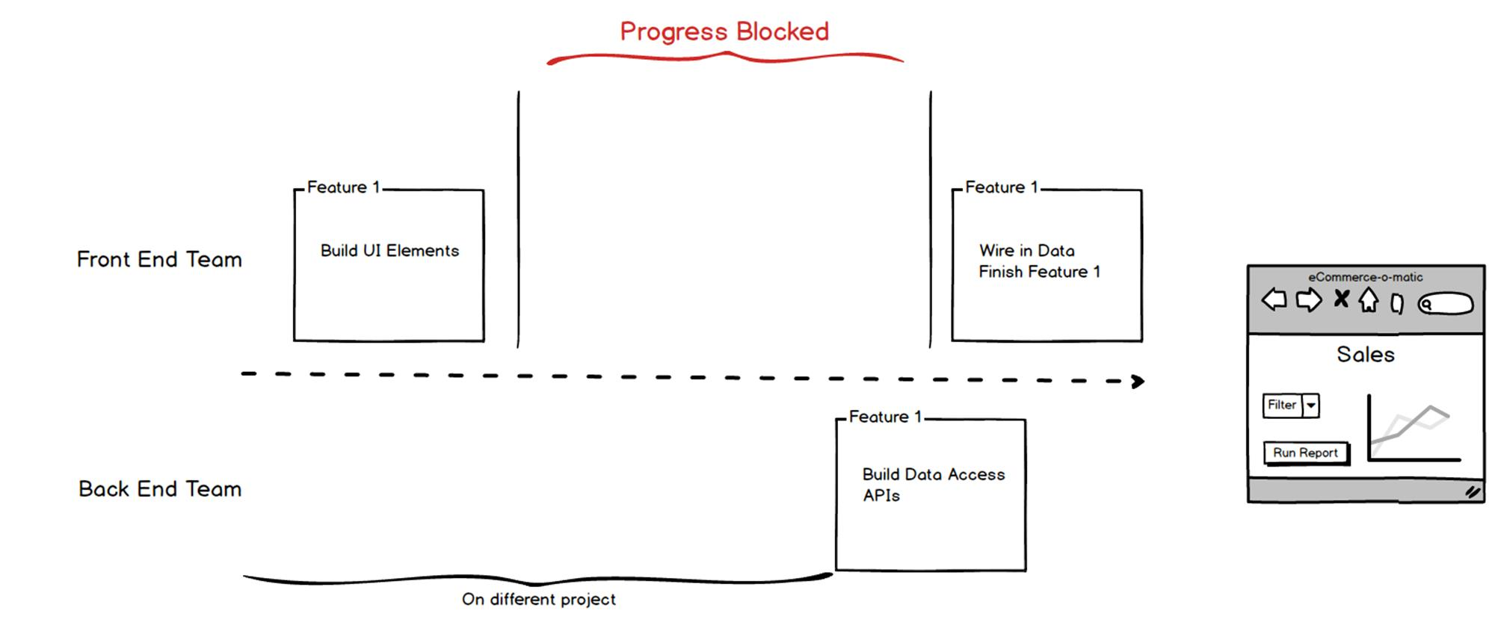

Decouple Development Start State

Slide 32
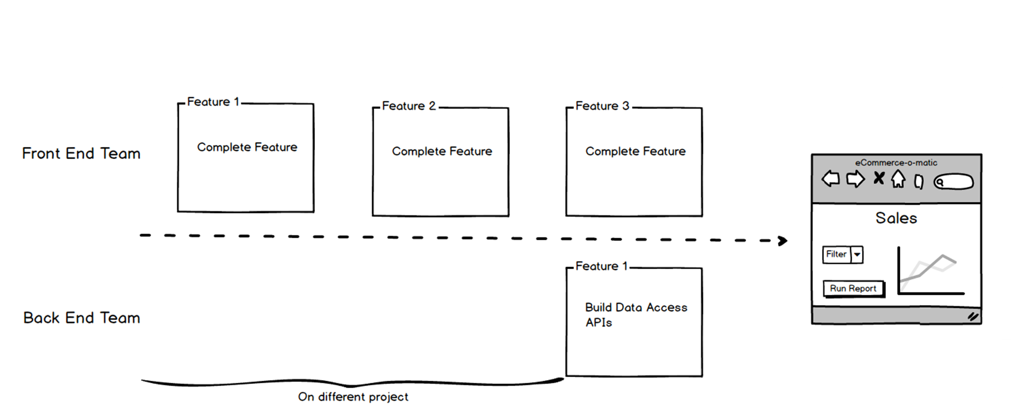
Decouple Development End State

Slide 33

Smaller things
Easier to understand
Easier to scale
Easier to version
Easier to share
Easier to retire
Notes:
Small things are easier to deal with in many ways
Move faster as a development organization

Slide 34

Notes:
In monoliths it is hard to retire functionality. If functionality is not retired, you end up having to drag this stuff forward as the application evolves. Additionally, security issues are a function of surface area, so if you have more code in production you have more security risk.
By decomposing functionality into smaller units, you can retire smaller elements when you are done.
The encapsulated nature of the APIs allows for discrete monitoring of functionality usage, so you can trace who is using it.

Slide 35

How do you get there?
Notes:
It’s hard, seeing all the shiny new stuff and not being able to justify the costs of how to get there.
Sometimes, though, the solution is quicker and cheaper than we think
You must be mindful of the strategy in order to be successful

Slide 36

ColdFusion API Manager
Notes:
Excited for this topic.
We are
Important feature to the platform
If you deal with older apps, a good strategy might be use what comes in the CF box
Competing products in this space are MUCH more expensive

Slide 37
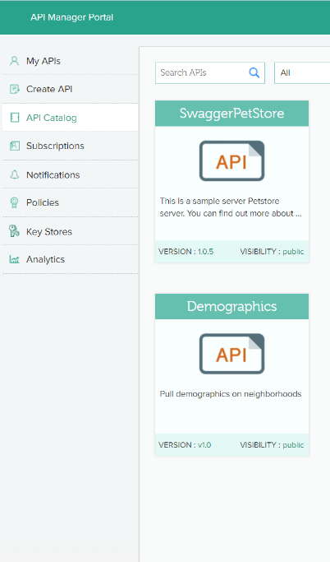
API Manager Facts
ColdFusion Enterprise
Separate Install (optional Docker)
Can manage APIs in any language
Can auto-create APIs from Swagger
Highly scalable
Can auto-convert SOAP to REST
Choose between XML or JSON responses
Built-in Analytics

Slide 38
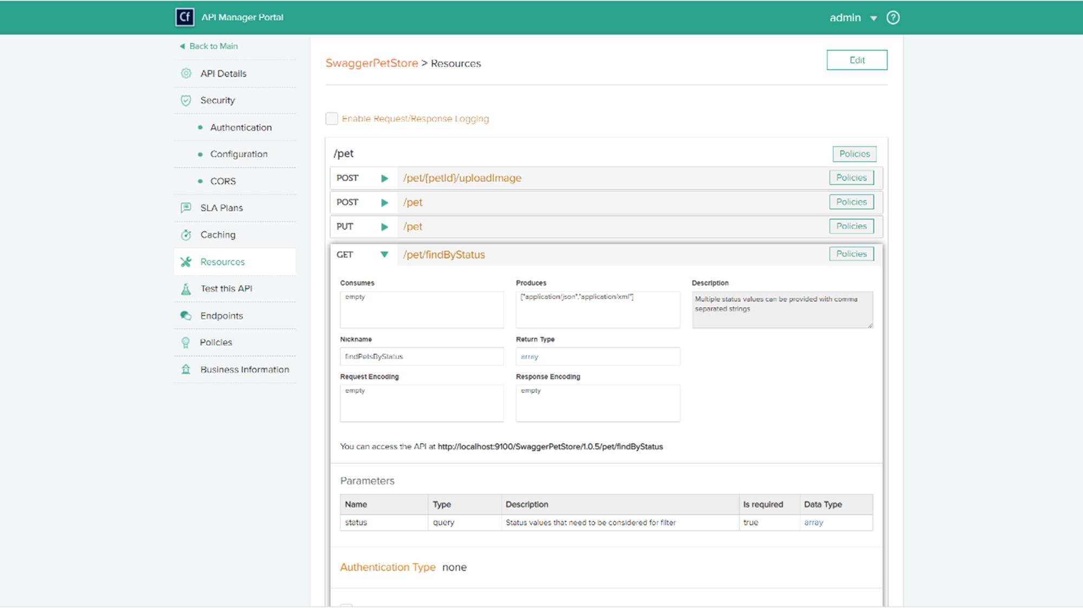
Notes:
Resource = Concept in your app
Verbs are what you can do to that concept
POST = Create
GET = Read
PUT = Update/Replace
PATCH = Update/Modify
DELETE = Delete

Slide 39
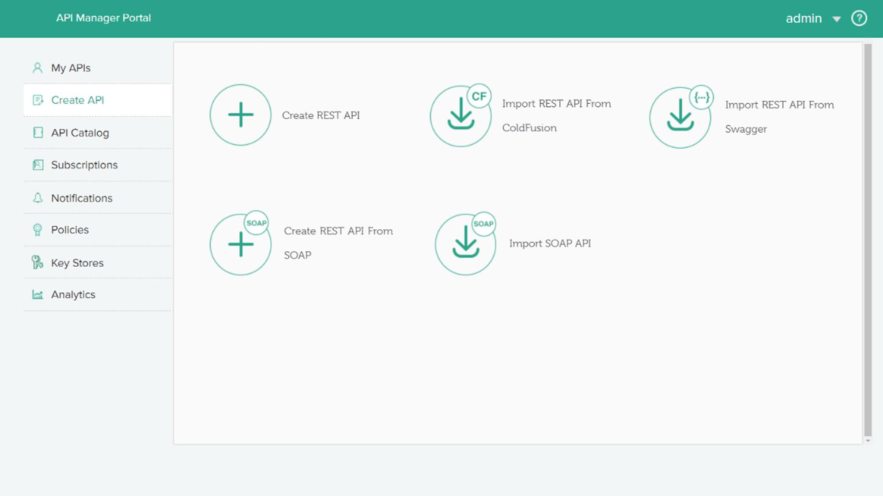
Favorite Features – Many ways. Free Code

Slide 40
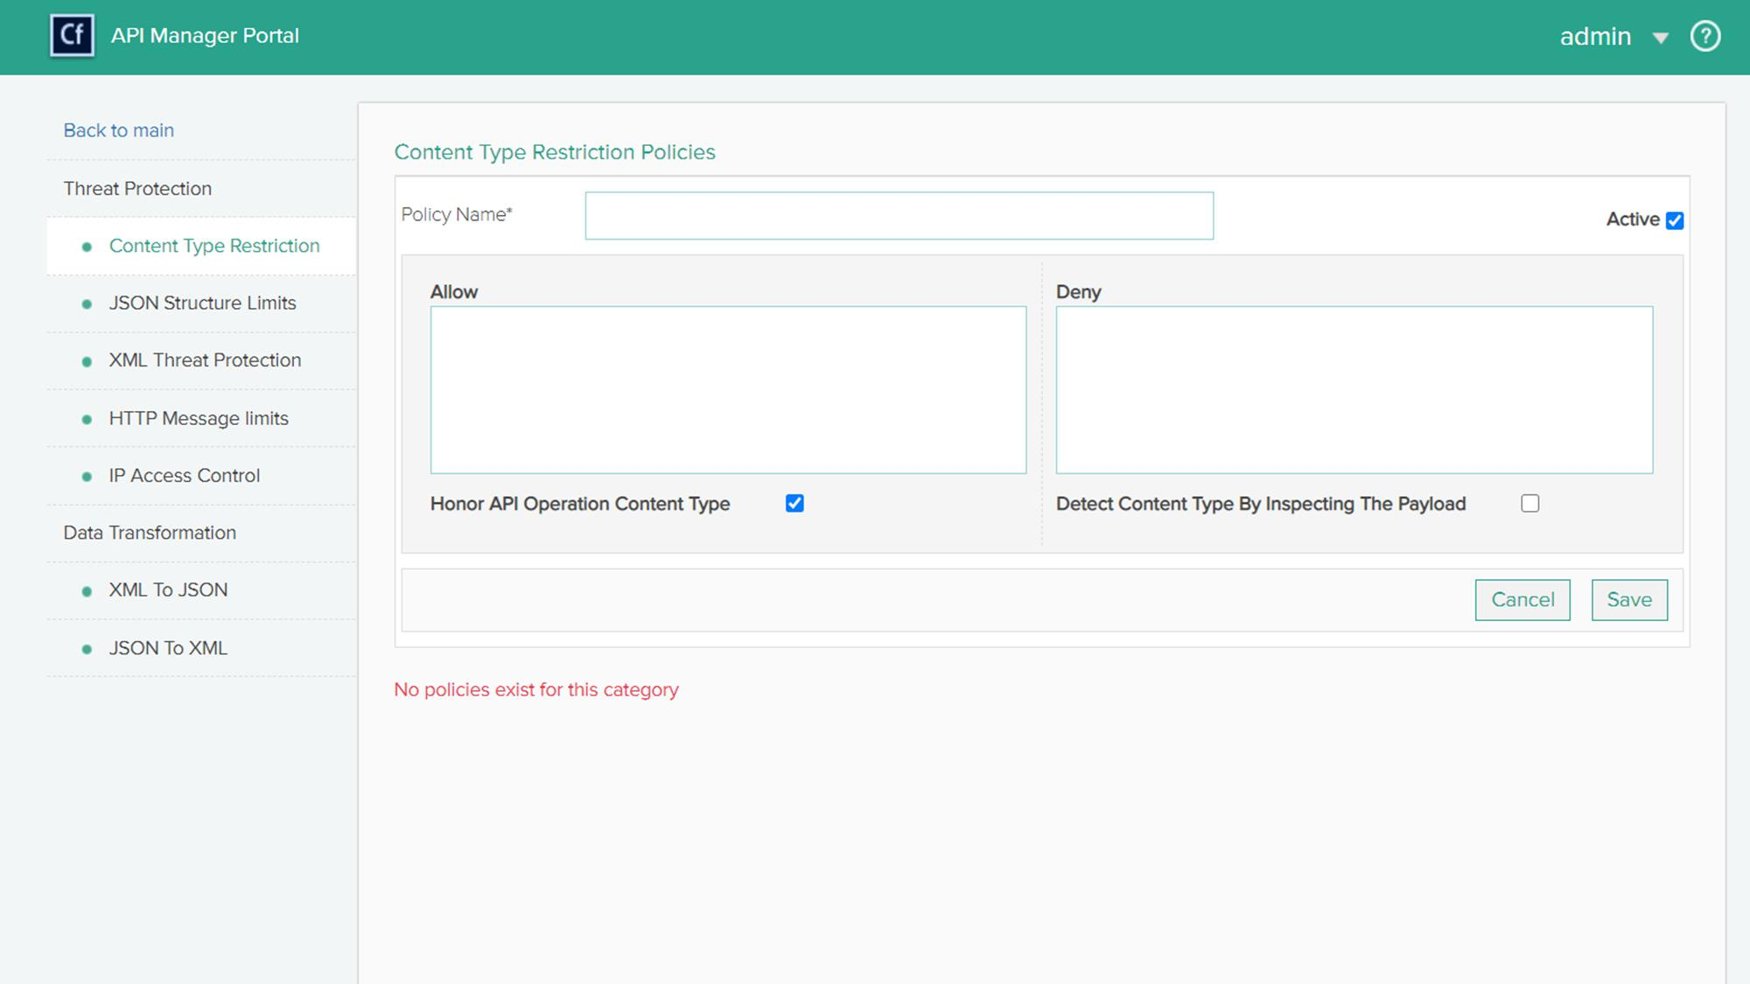
Favorite Features – Transform Data / Guard Against Malicious Actors

Slide 41
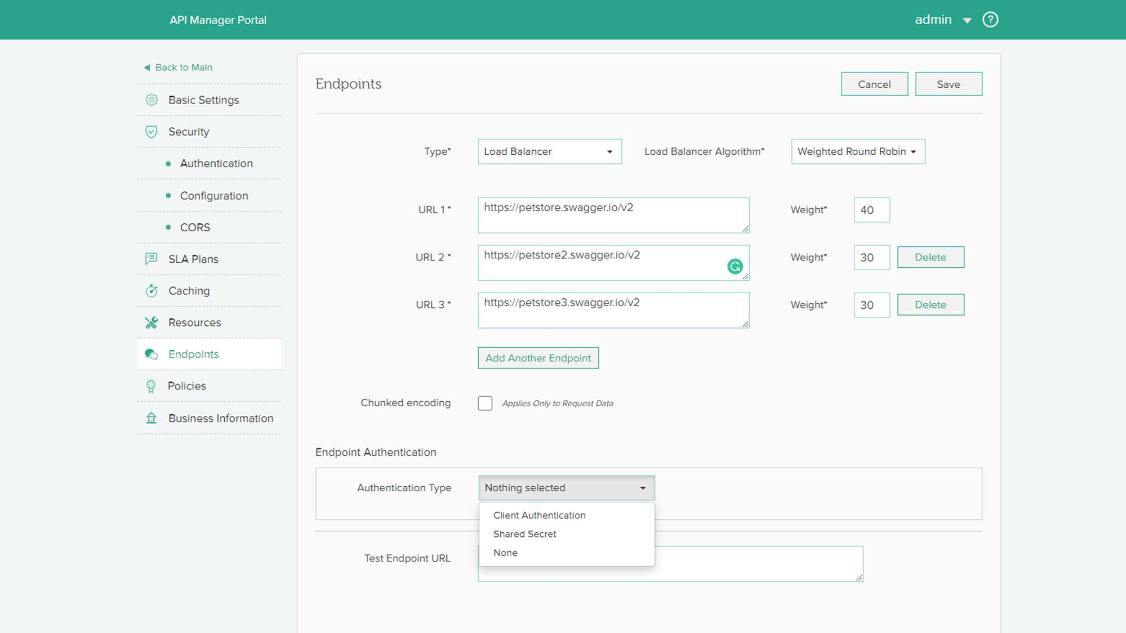
Favorite Features – Free Load Balancer
Notes:
Load balancer can use Round Robin, or Weighting

Slide 42
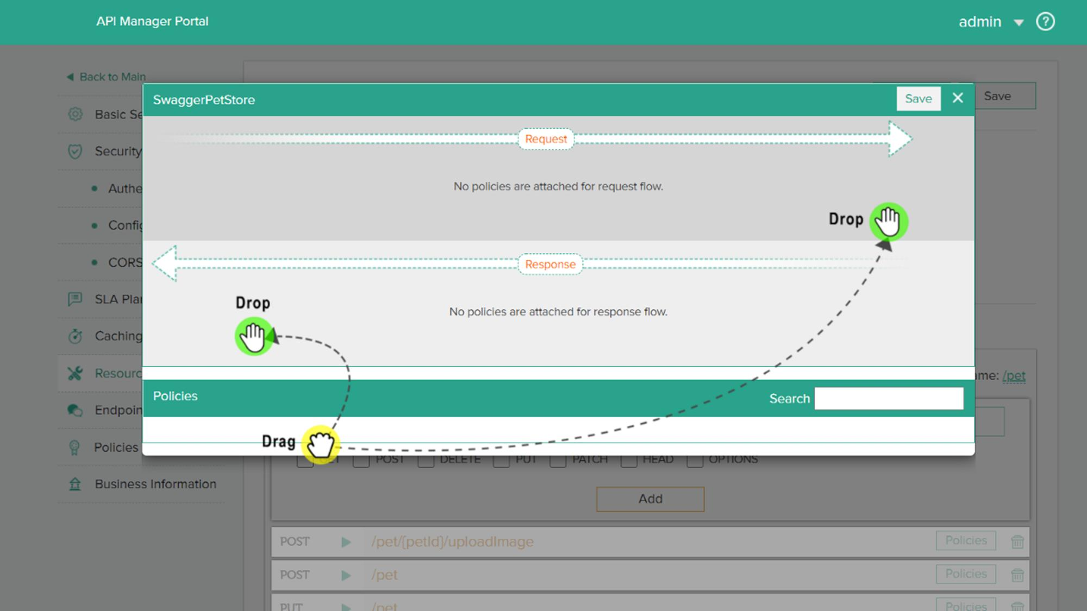
Attach policies to specific resources.
Request and/or Response

Slide 43
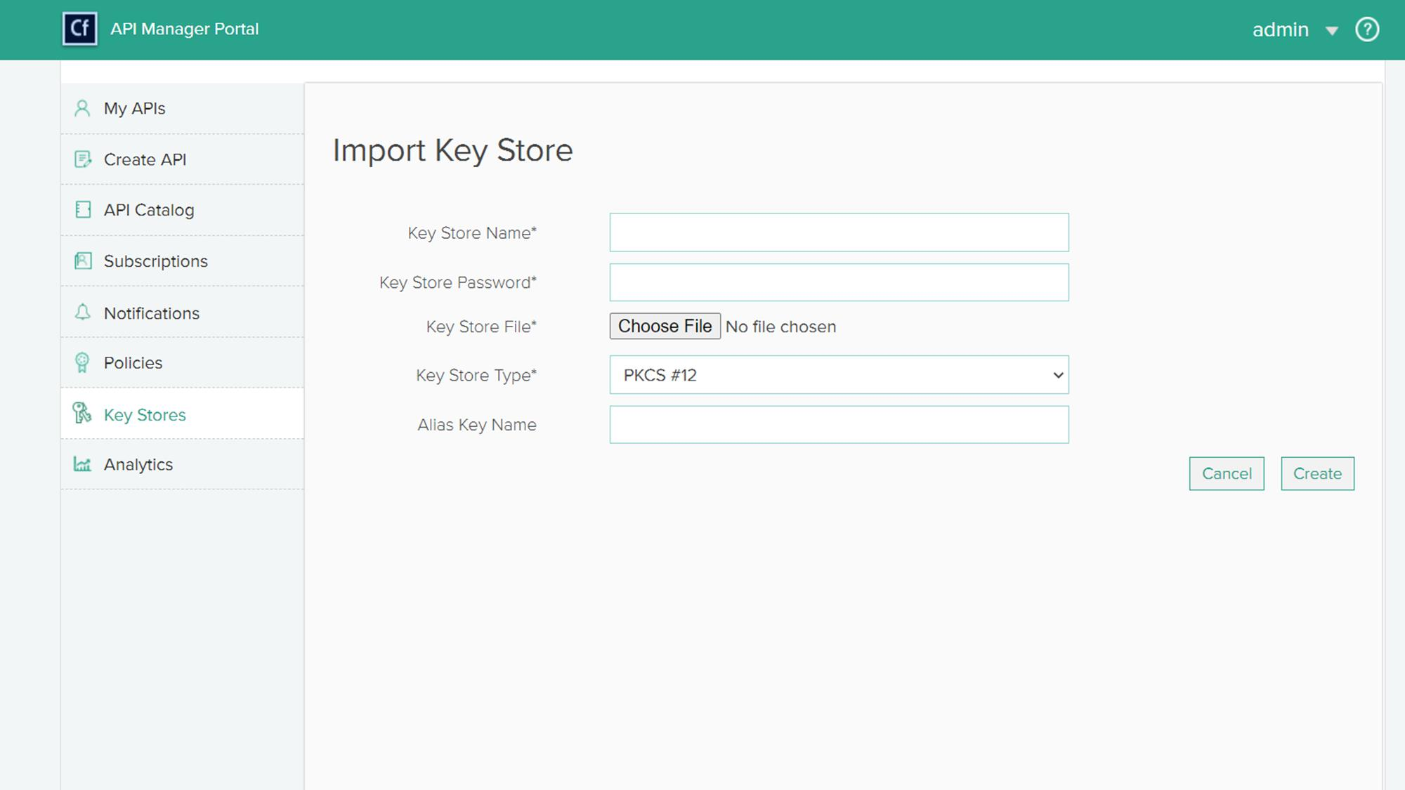
Favorite Features – Centralized Key Stores
Notes:
Keep all authentication together in one part.
Create a keystore or import an existing keystore

Slide 44
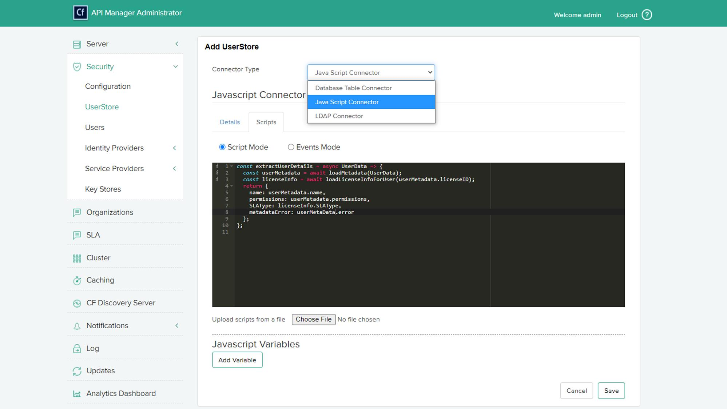
Favorite Features – User Stores
Notes:
You connect to databases, LDAPs or roll your own with the JavaScript connector which lets you write API calls in JavaScript.

Slide 45
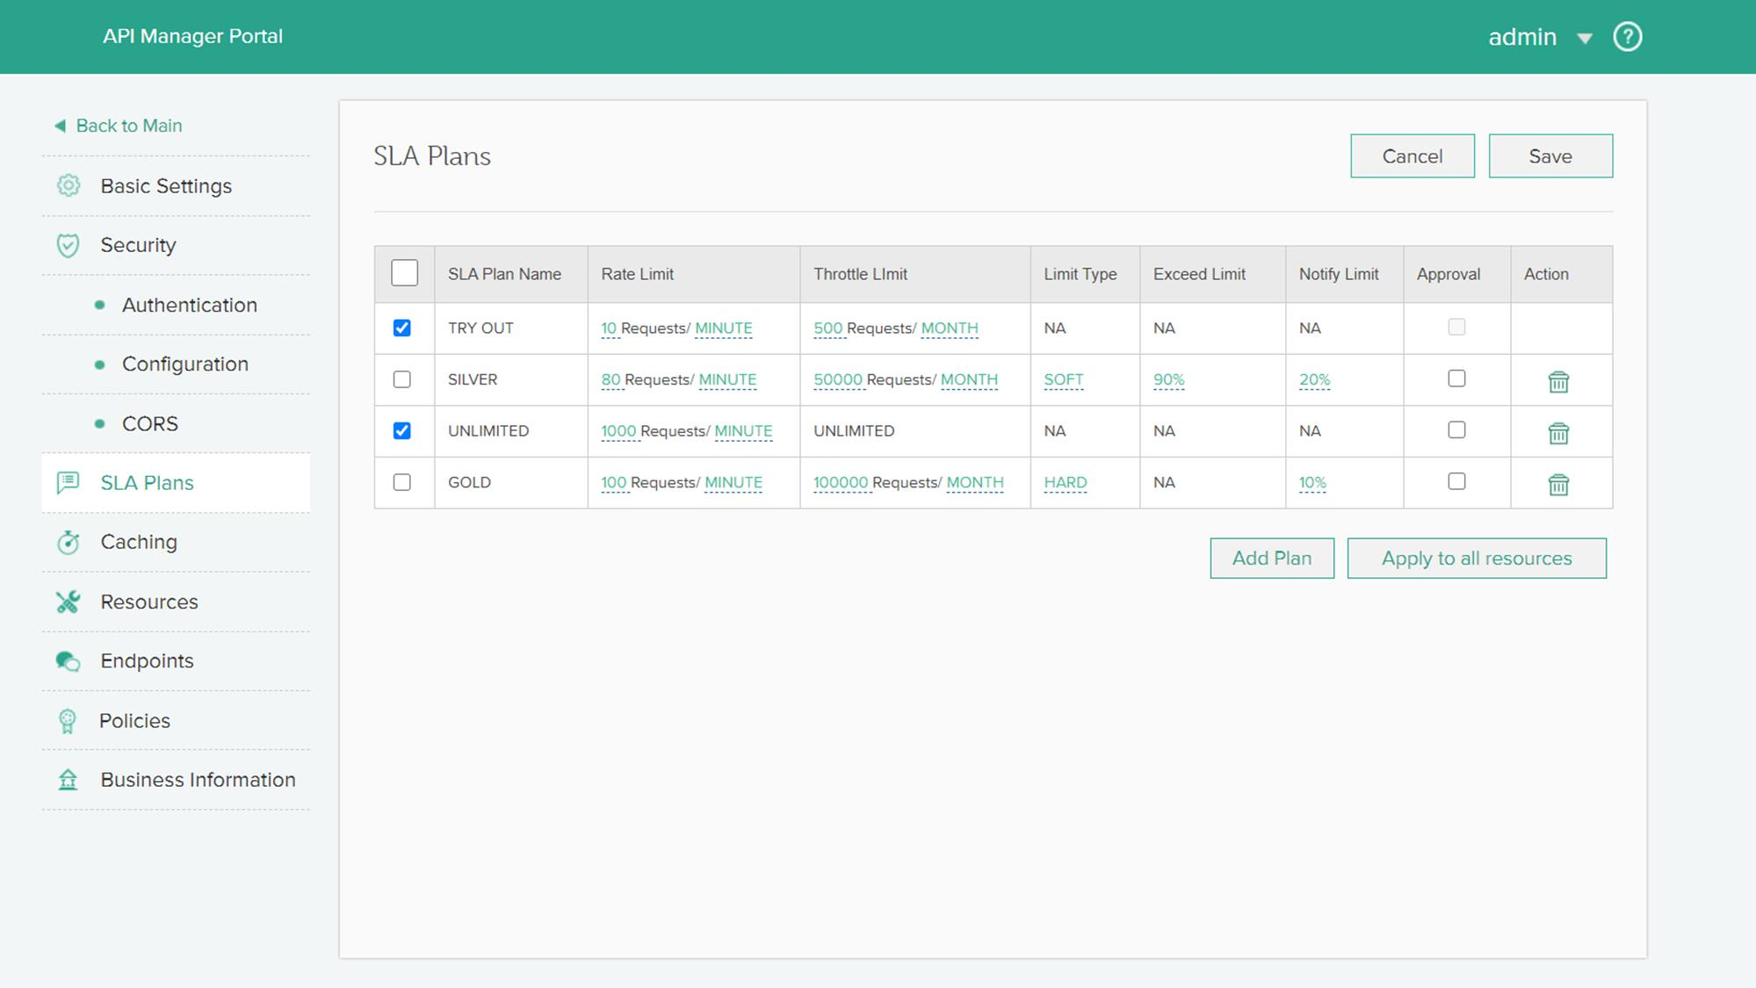
Favorite Features – Rate Limits, Throttles, etc…
Notes:
Important for SaaS vendors
Also important to trim load on non-essential systems. Can be done at runtime if you need to take off load

Slide 46
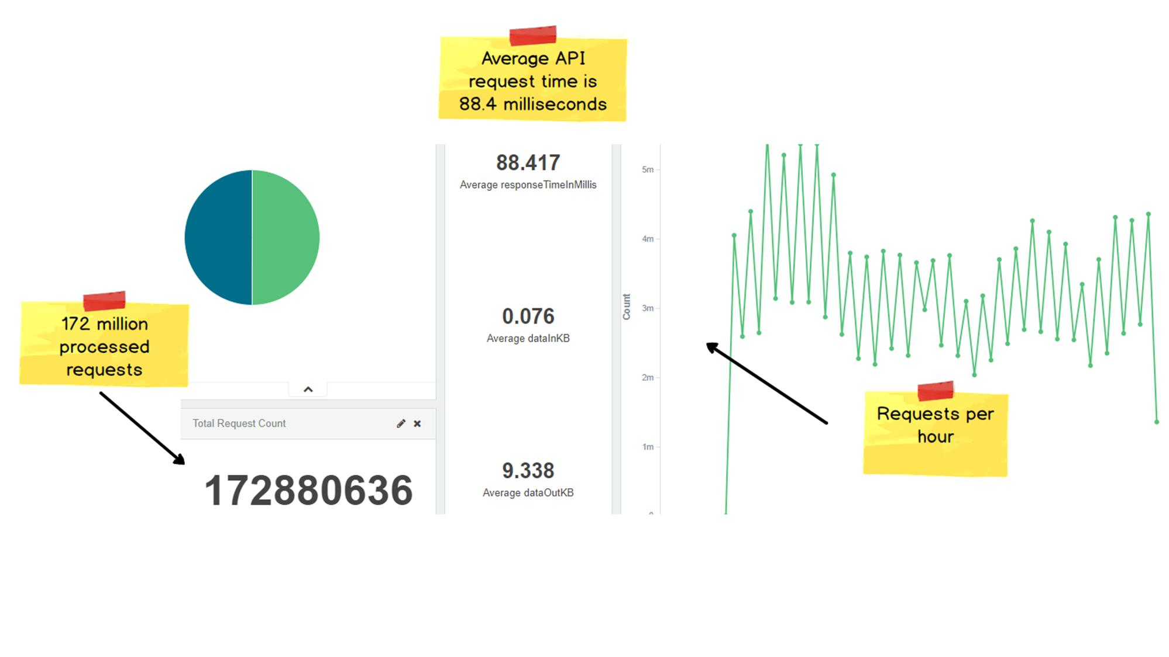
Favorite Features – Built-in Analytics/Metrics
Notes:
In-built monitoring to track activity, health, performance, and diagnosis data

Slide 47

Inception: The API Manager can be configured and controlled with APIs
Notes:
You can use APIs to make API keys, add security, tweak configuration, whatever you want!

Slide 48
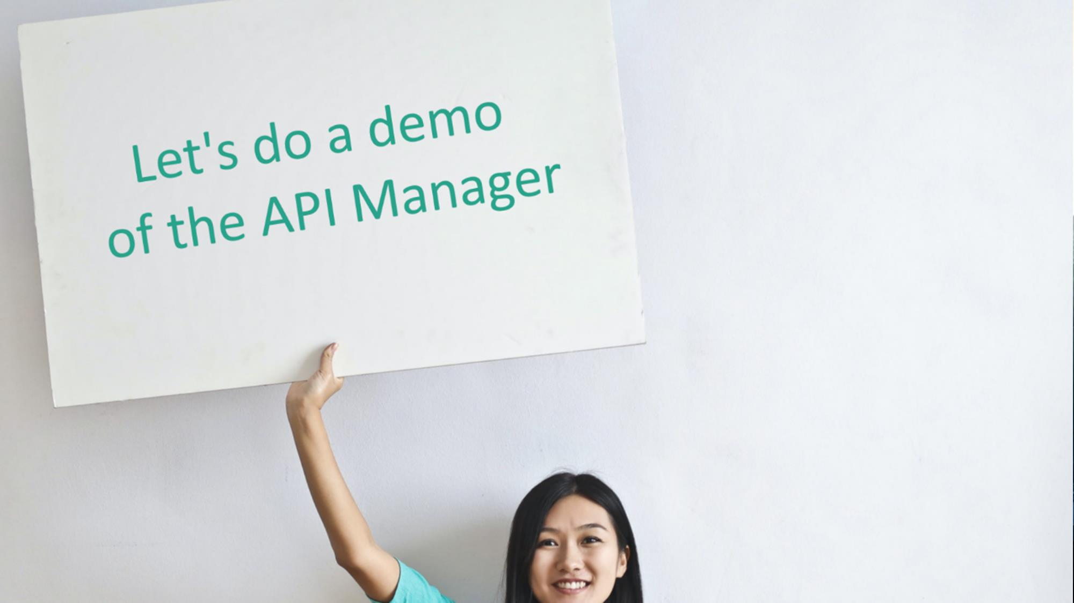
Demo time
Notes:
Run through a few examples real quick

Slide 49

@DanWilson digitalprimates.net
https://www.linkedin.com/in/profileofdanwilson/

